Slide 1





Bangladesh Army University of Science & Technology, Khulna
Department of Computer Science & Engineering
Tentative Title:
Hospital Management System
Presented by : Supervised By :
Nandini Saha Rohul Amin
Id : 1072420005101007 Lecturer
Level : 02 Term : 02 Department of CSE
Semester : January 2026 BAUST, Khulna
Presented by : Kyrie Petrakis

Slide 2


Overview
Hospital Management System is a Java-based OOP project that helps manage patients, doctors, appointments, and medical records efficiently. It reduces manual work and improves the overall hospital management process.

Slide 3

Table of Contents
01
Introduction
07
Database Information
02
Objectives
08
Challenges & Soluution
03
Main Modules
09
System Workflow
04
Input & Output
10
Advantages
05
OOP Concepts Used
11
Future Scope
06
Key Features
12
Conclusion

Slide 4

Introduction
What is Hospital Management System?
* Manages hospital operations efficiently
* Stores patient and doctor information
* Handles appointments and records
* Reduces paperwork and manual errors
* Developed using Java and OOP concepts

Slide 5

Project Objectives
✔ Manage patient information
✔ Store doctor details
✔ Schedule appointments
✔ Maintain medical records
✔ Improve hospital efficiency

Slide 6
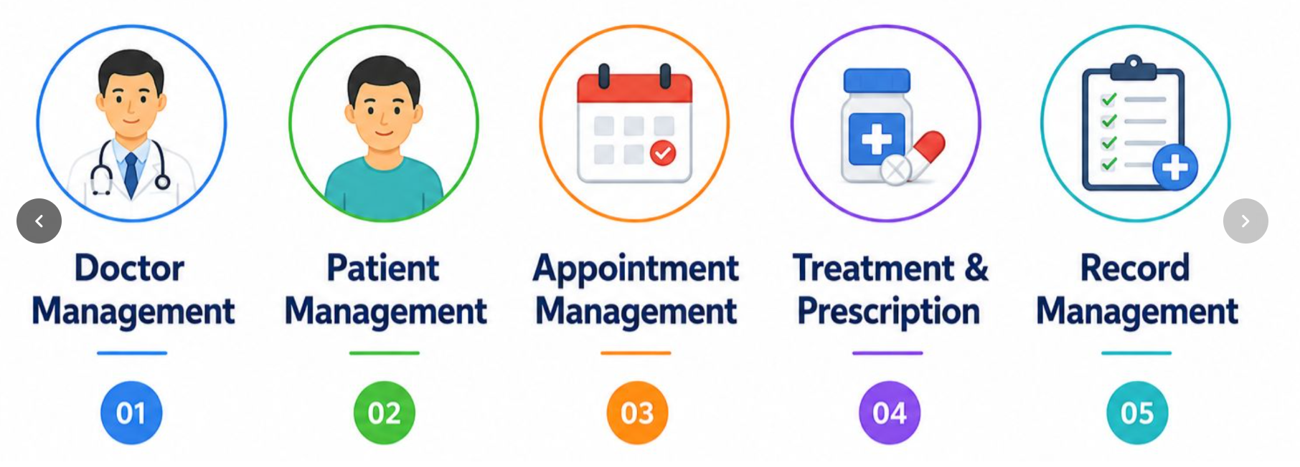


Main Modules
02

Slide 7







Input & Output
01
Input
Output
02
Patient ID
Patient Name
Age & Gender
Doctor Information
Appointment Date
Patient Details
Doctor Details
Appointment Status
Medical Records

Slide 8
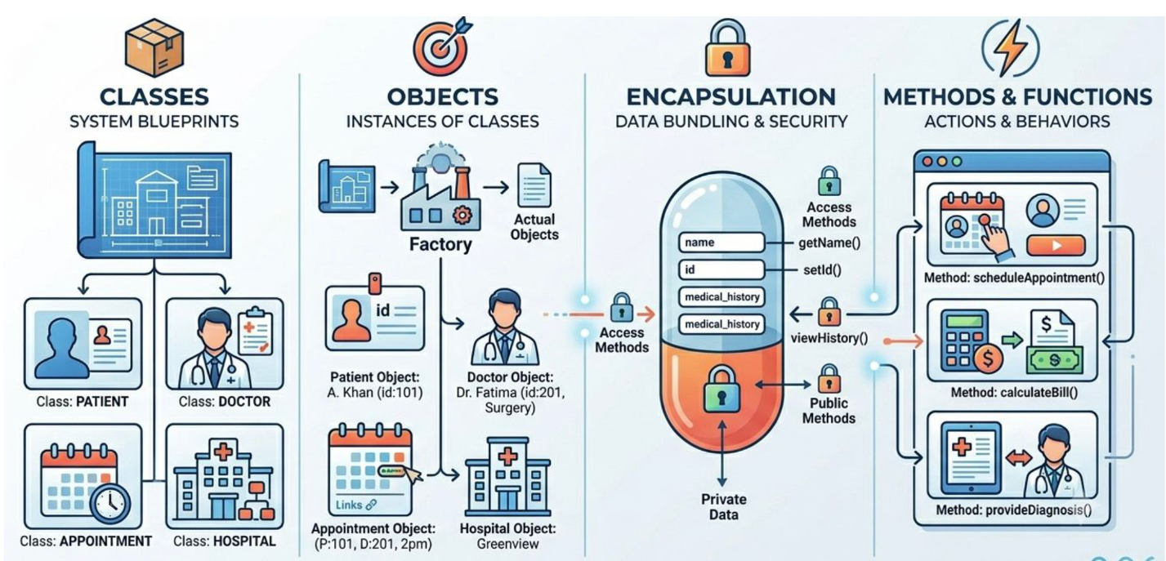
OOP Concepts Used

Slide 9
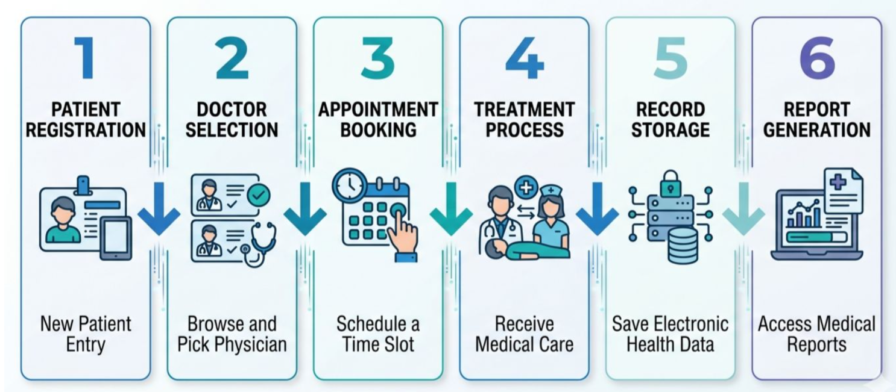
System Workflow

Slide 10
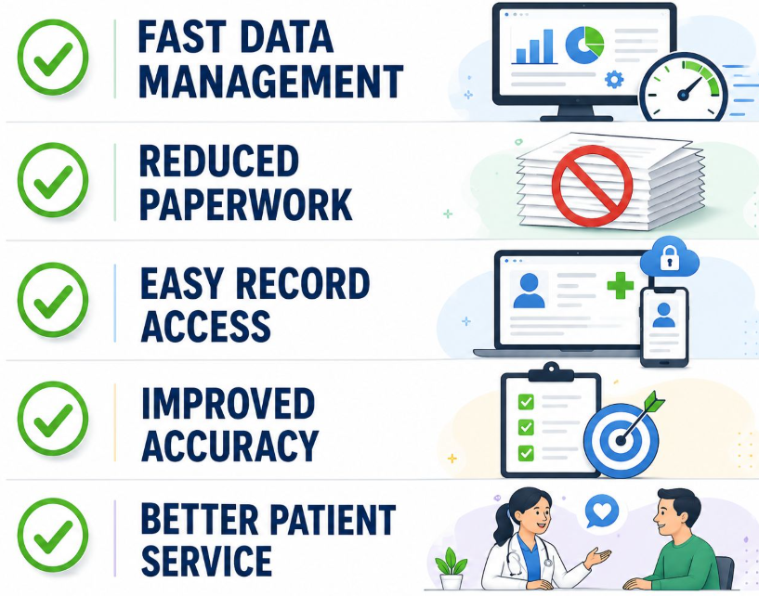
ADVANTAGES

Slide 11
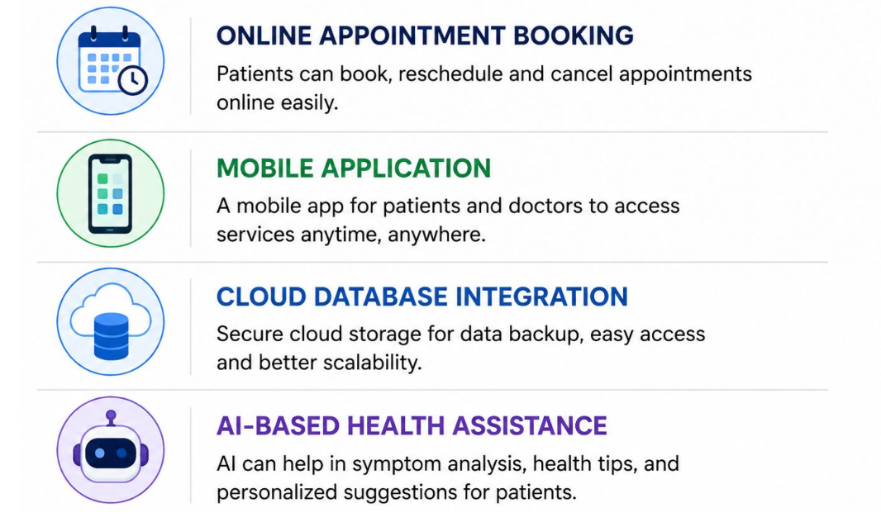
Future Scope

Slide 12

Conclusion

Slide 13
References
1. Herbert Schildt, Java: The Complete Reference, 12th Edition, McGraw-Hill Education, 2021.
* Chapter 6: Classes and Objects
* Chapter 8: Inheritance
* Chapter 9: Packages and Interfaces
2. Cay S. Horstmann, Core Java Volume I – Fundamentals, 12th Edition, Pearson, 2021.
* Chapter 4: Objects and Classes
* Chapter 5: Inheritance
* Chapter 6: Interfaces and Lambda Expressions
3. E. Balagurusamy, Programming with Java, McGraw-Hill Education.
* OOP Concepts Section
* Java Classes and Objects Section
Online Resources
* Oracle Java Documentation⁠￼
* W3Schools Java Tutorial⁠￼

Slide 14
ANY QUESTION ?
Presented by : Kyrie Petrakis

Slide 15
THANK YOU
Presented by : Kyrie Petrakis

